Slide 1
Relational Algebra & Calculus
Chapter 4, Part A (Relational Algebra)
Notes:
1
The slides for this text are organized into chapters. This lecture covers relational algebra, from Chapter 4. The relational calculus part can be found in Chapter 4, Part B.
Examples are used extensively. The text and chapter exercises contain numerous additional examples, and I often ask students to do several of these as assignments.
This material is important for two reasons:
It is a foundation for SQL. This is an important reason to cover algebra in detail, but the discussion of SQL in the book does NOT depend on a detailed understanding of algebra. Instructors who prefer to explain the basic algebra operators and skip the discussion of how to write a wide range of queries in algebra can safely do so.
It is a foundation for query processing. Students need to know what each operator does, and how they can be composed in queries. Again, it is possible to skip a detailed discussion of how to write complex queries in algebra, and this is left to the instructor’s discretion.

Slide 2
Relational Query Languages
Query languages: Allow manipulation and retrieval of data from a database.
Relational model supports simple, powerful QLs:
  Strong formal foundation based on logic.
  Allows for much optimization.
Query Languages != programming languages!
  QLs not expected to be “Turing complete”.
  QLs not intended to be used for complex calculations.
  QLs support easy, efficient access to large data sets.
Notes:
2

Slide 3
Formal Relational Query Languages
Two mathematical Query Languages form the basis for “real” languages (e.g. SQL), and for implementation:
  Relational Algebra: More operational (procedural), very useful for representing execution plans.
  Relational Calculus: Lets users describe what they want, rather than how to compute it: Non-operational, declarative.

Slide 4
Preliminaries
A query is applied to relation instances, and the result of a query is also a relation instance.
  Schemas of input relations for a query are fixed.
  The schema for the result of a given query is also fixed! - determined by definition of query language constructs.
Positional vs. named-field notation:
  Positional notation easier for formal definitions, named-field notation more readable.
  Both used in SQL
Notes:
4

Slide 5
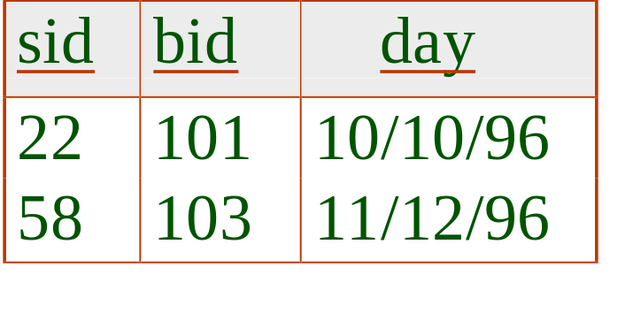
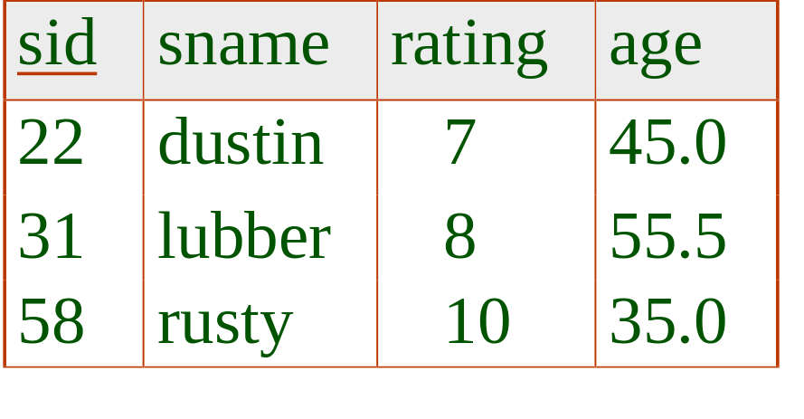
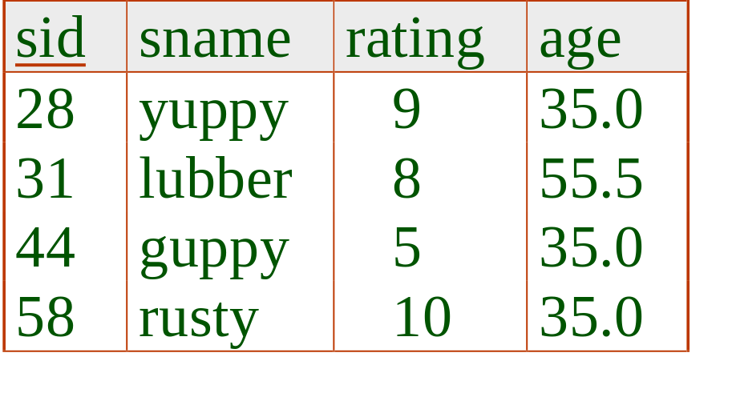
Example Instances
R1
“Sailors” and “Reserves” relations for our examples.
We’ll use positional or named field notation, assume that names of fields in query results are `inherited’ from names of fields in query input relations.
S1
S2
Notes:
5

Slide 6
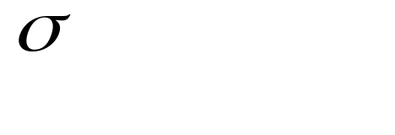
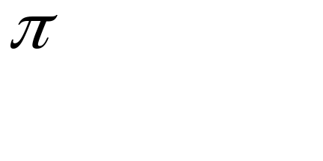



Relational Algebra
Basic operations:
  Selection ( ) Selects a subset of rows from relation.
  Projection ( ) Deletes unwanted columns from relation.
  Cross-product ( ) Allows us to combine two relations.
  Set-difference ( ) Tuples in reln. 1, but not in reln. 2.
  Union ( ) Tuples in reln. 1 and in reln. 2.
Additional operations:
  Intersection, join, division, renaming: Not essential, but (very!) useful.
Since each operation returns a relation, operations can be composed: algebra is “closed”.
Notes:
6

Slide 7
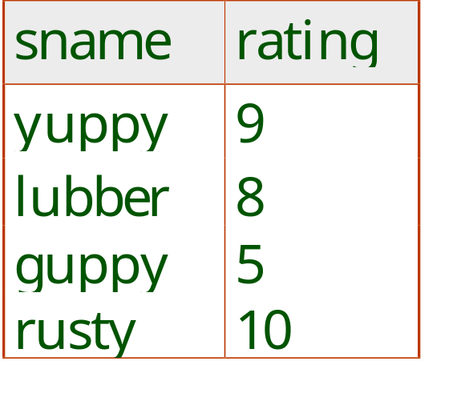
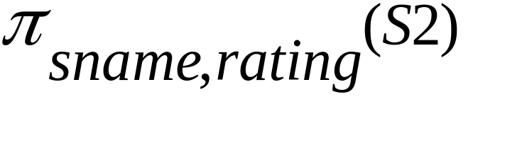
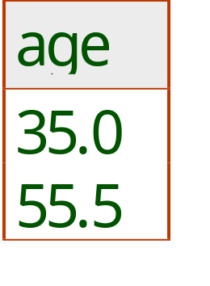
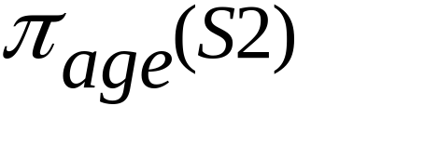
Projection
Deletes attributes that are not in projection list.
Schema of result contains exactly the fields in the projection list, with the same names that they had in the input relation.
Projection operator has to eliminate duplicates! Why?
  Note: real systems typically don’t do duplicate elimination unless the user explicitly asks for it (by DISTINCT). Why not?
Notes:
7

Slide 8
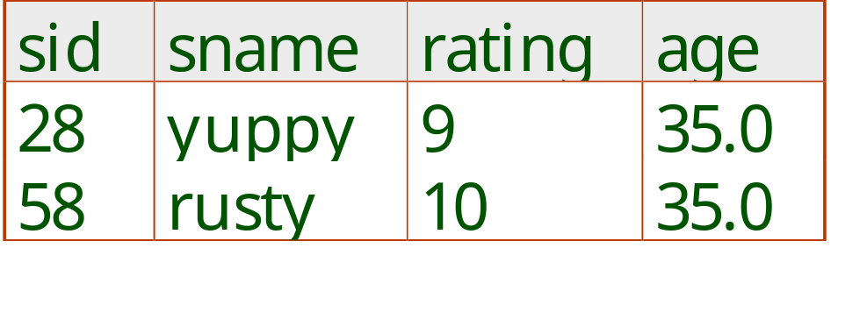
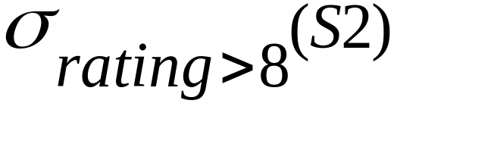
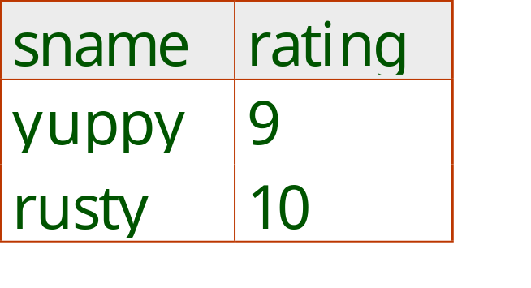
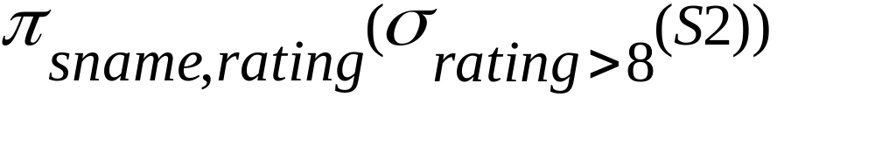
Selection
Selects rows that satisfy selection condition.
No duplicates in result! Why?
Schema of result identical to schema of input relation.
What is Operator composition?
Selection is distributive over binary operators
Selection is commutative
Notes:
8

Slide 9
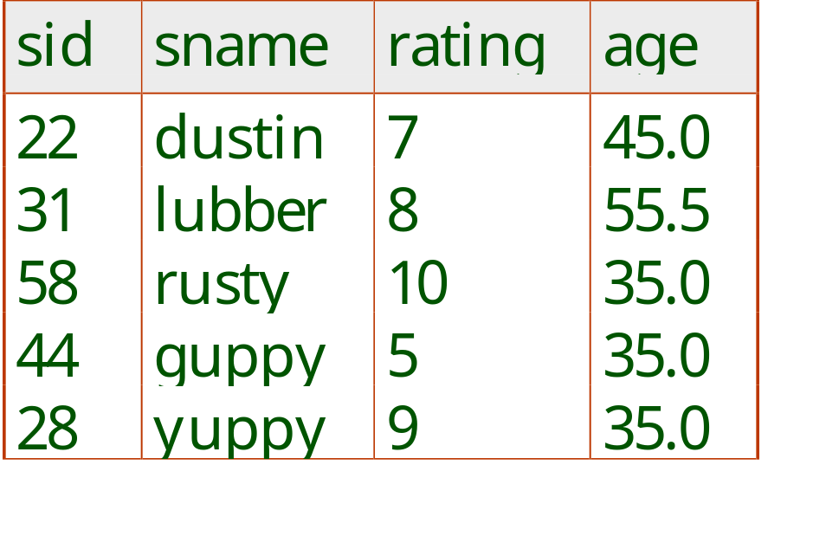
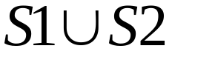
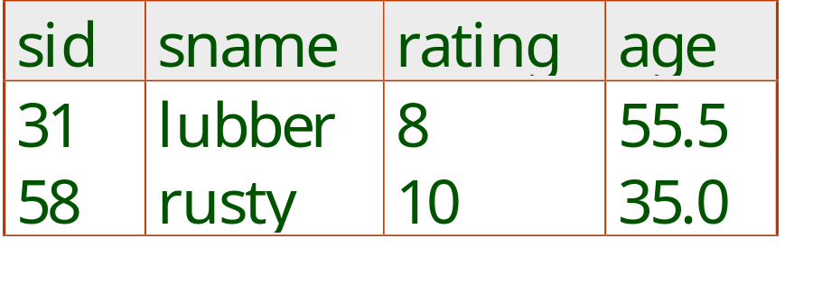
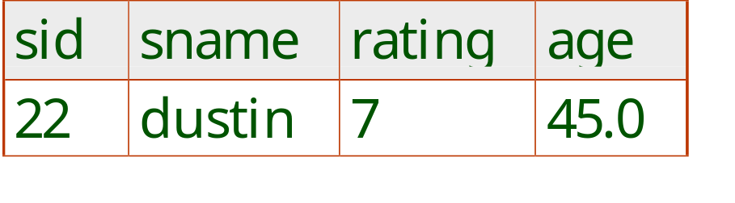

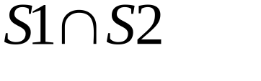
Union, Intersection, Set-Difference
All of these operations take two input relations, which must be union-compatible:
  Same number of fields.
  `Corresponding’ fields have the same type.
What is the schema of result?
Notes:
9

Slide 10
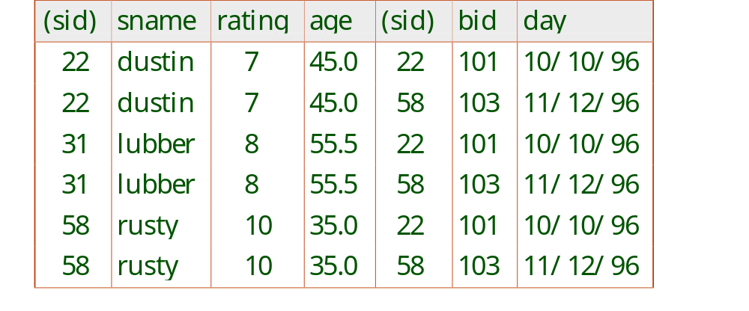
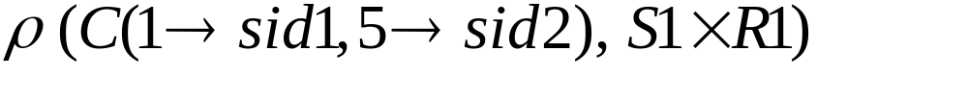
Cross-Product (Cartesian Product)
Each row of S1 is paired with each row of R1.
Result schema has one field per field of S1 and R1, with field names `inherited’ if possible.
  Conflict: Both S1 and R1 have a field called sid.
Renaming operator:
Notes:
10

Slide 11

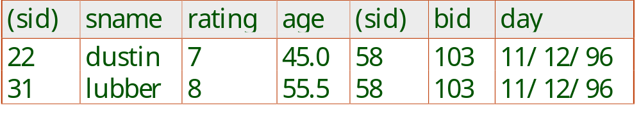
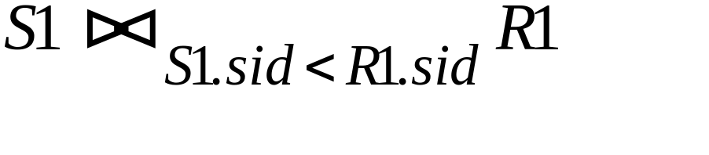
Joins: used to combine relations
Condition Join:
Result schema same as that of cross-product.
Fewer tuples than cross-product, might be able to compute more efficiently
Sometimes called a theta-join.
Notes:
11

Slide 12
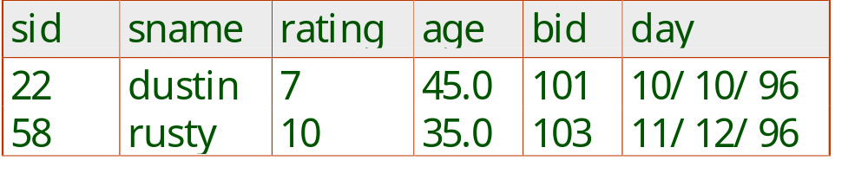
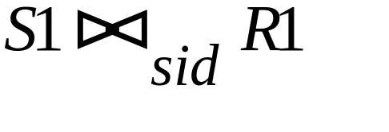
Join
Equi-Join: A special case of condition join where the condition c contains only equalities.
Result schema similar to cross-product, but only one copy of fields for which equality is specified.
Natural Join: Equijoin on all common fields.
Notes:
12

Slide 13


Properties of join
Selecting power: can join be used for selection?
Is join commutative? = ?
Is join associative?
Join and projection perform complementary functions
Lossless and lossy decomposition
Notes:
12

Slide 14
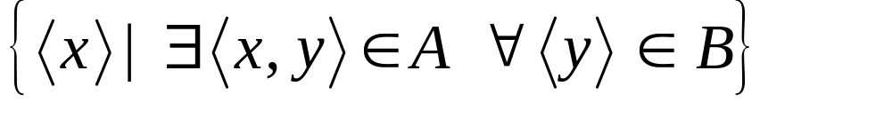

Division
Not supported as a primitive operator, but useful for expressing queries like: Find sailors who have reserved all boats.
Let A have 2 fields, x and y; B have only field y:
  A/B =
  i.e., A/B contains all x tuples (sailors) such that for every y tuple (boat) in B, there is an xy tuple in A.
  Or: If the set of y values (boats) associated with an x value (sailor) in A contains all y values in B, the x value is in A/B.
In general, x and y can be any lists of fields; y is the list of fields in B, and x y is the list of fields of A.
Notes:
13

Slide 15
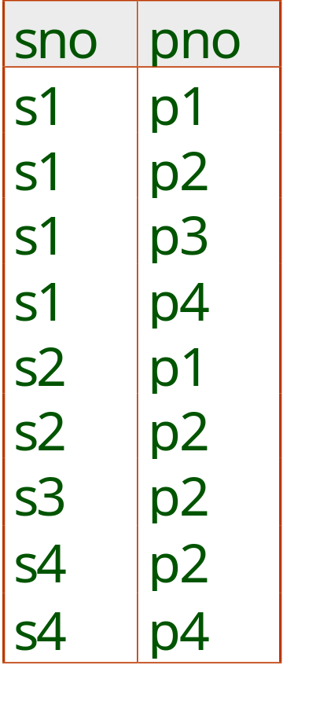
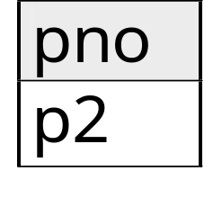
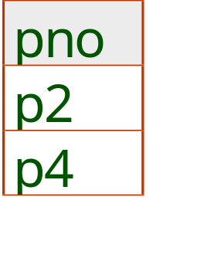
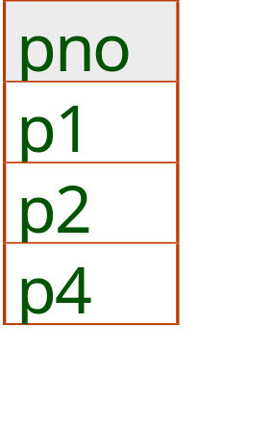
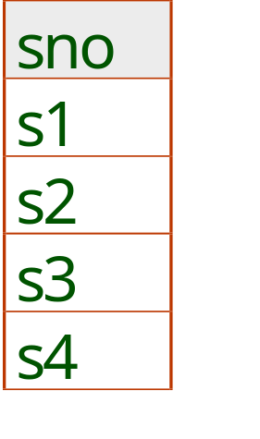
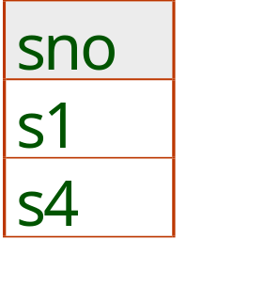
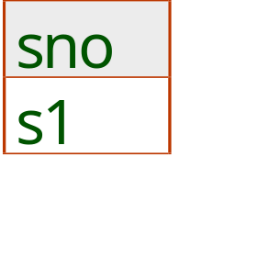
Examples of Division A/B
B1
B2
B3
A
A/B1
A/B2
A/B3
Notes:
14

Slide 16
Example of Division
Find all customers who have an account at all branches located in Chville
  Branch (bname, assets, bcity)
  Account (bname, acct#, cname, balance)
Notes:
14

Slide 17
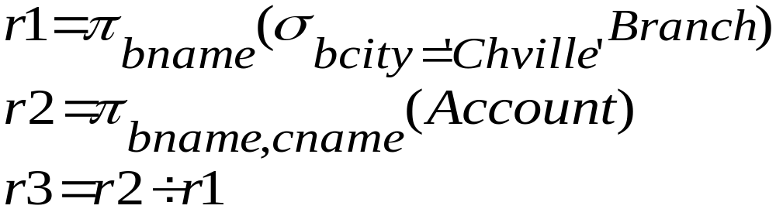
Example of Division
R1: Find all branches in Chville
R2: Find (bname, cname) pair from Account
R3: Customers in r2 with every branch name in r1
Notes:
14

Slide 18
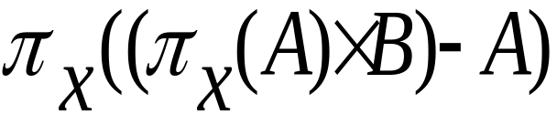
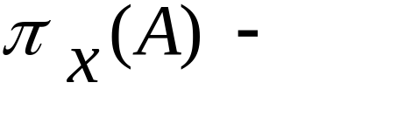
Expressing A/B Using Basic Operators
Division is not essential op; just a useful shorthand.
  Also true of joins, but joins are so common that systems implement joins specially.
Idea: For A/B, compute all x values that are not `disqualified’ by some y value in B.
  x value is disqualified if by attaching y value from B, we obtain an xy tuple that is not in A.
  Disqualified x values:
A/B:
all disqualified tuples
Notes:
15

Slide 19
Exercises
Given relational schema:
  Sailors (sid, sname, rating, age)
  Reservation (sid, bid, date)
  Boats (bid, bname, color)
Find names of sailors who’ve reserved boat #103
Find names of sailors who’ve reserved a red boat
Find sailors who’ve reserved a red or a green boat
Find sailors who’ve reserved a red and a green boat
Find the names of sailors who’ve reserved all boats
Notes:
16

Slide 20
Summary of Relational Algebra
The relational model has rigorously defined query languages that are simple and powerful.
Relational algebra is more operational; useful as internal representation for query evaluation plans.
Several ways of expressing a given query; a query optimizer should choose the most efficient version.

Slide 21
Relational Algebra & Calculus
Chapter 4, Part B (Relational Calculus)
Notes:
The slides for this text are organized into chapters. This lecture covers relational calculus from Chapter 4. The relational algebra part can be found in Chapter 4, Part A.
We only discuss Domain Relational Calculus (DRC).; the slides must be adapted to cover TRC (which is discussed in the text).
Relational calculus is part of the foundation for SQL, and a good grasp of this material is helpful when studying SQL. However, the coverage of SQL in the text does not rely upon a knowledge of calculus, and instructors who choose to omit coverage of calculus can do so safely.

Slide 22
Relational Calculus
Comes in two flavors: Tuple relational calculus (TRC) and Domain relational calculus (DRC).
Calculus has variables, constants, comparison ops, logical connectives and quantifiers.
  TRC: Variables range over (i.e., get bound to) tuples.
  DRC: Variables range over domain elements (= field values).
  Both TRC and DRC are simple subsets of first-order logic.
Expressions in the calculus are called formulas. An answer tuple is essentially an assignment of constants to variables that make the formula evaluate to true.

Slide 23
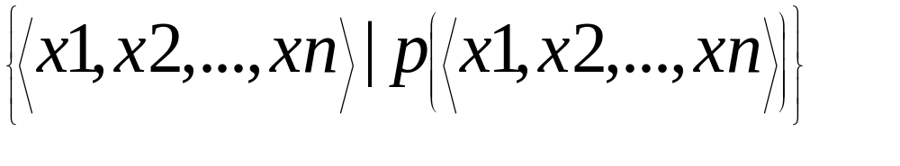
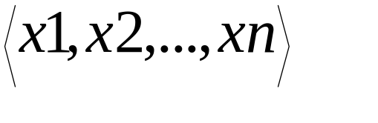
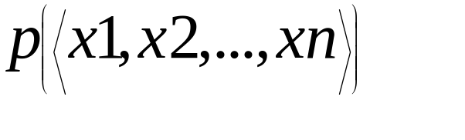
Domain Relational Calculus
Query has the form:
Answer includes all tuples that
make the formula be true.
Formula is recursively defined, starting with
simple atomic formulas (getting tuples from
relations or making comparisons of values),
and building bigger and better formulas using
the logical connectives.

Slide 24
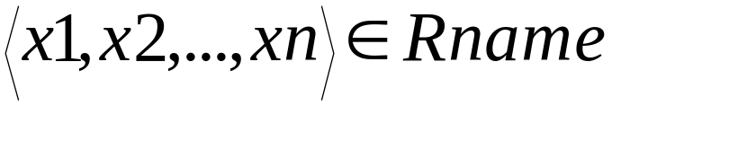

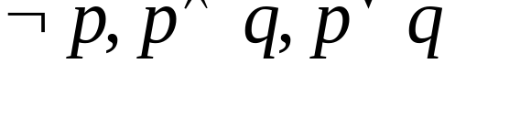
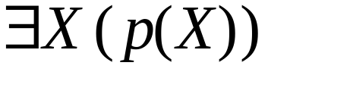
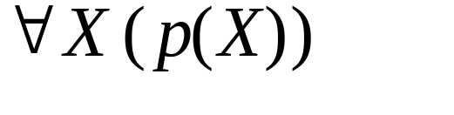

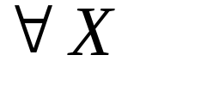
DRC Formulas
Atomic formula:
  , or X op Y, or X op constant
  op is one of
Formula:
  an atomic formula, or
  , where p and q are formulas, or
  , where X is a domain variable or
  , where X is a domain variable.
The use of quantifiers and is said to bind X.

Slide 25
Free and Bound Variables
The use of quantifiers and in a formula is said to bind X.
  A variable that is not bound is free.
Let us revisit the definition of a query:
There is an important restriction: the variables x1, ..., xn that appear to the left of `|’ must be the only free variables in the formula p(...).

Slide 26
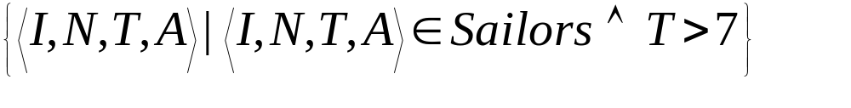
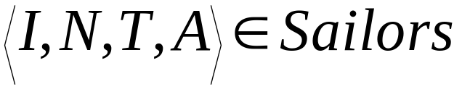
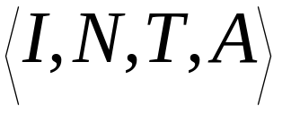
Find all sailors with a rating above 7
The condition ensures that the domain variables I, N, T and A are bound to fields of the same Sailors tuple.
The term to the left of `|’ (which should be read as such that) says that every tuple that satisfies T>7 is in the answer.
Modify this query to answer:
  Find sailors who are older than 18 or have a rating under 9, and are called ‘Joe’.

Slide 27
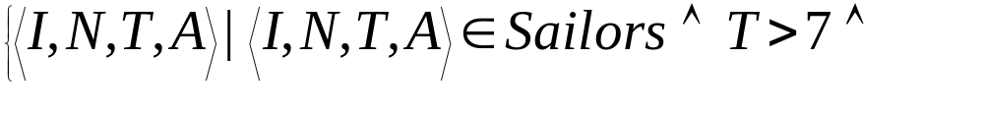
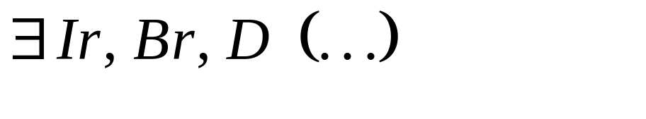
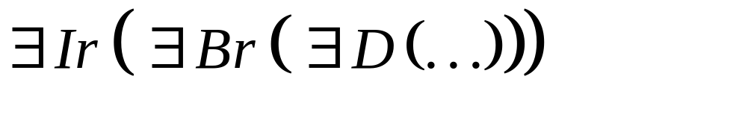

Find sailors rated > 7 who have reserved boat #103
We have used as a shorthand for
Note the use of to find a tuple in Reserves that `joins with’ the Sailors tuple under consideration.

Slide 28
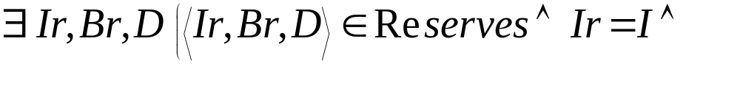

Find sailors rated > 7 who’ve reserved a red boat
Observe how the parentheses control the scope of each quantifier’s binding.
This may look cumbersome, but with a good user interface, it could be intuitive. (MS Access, QBE)

Slide 29




Find sailors who’ve reserved all boats
Find all sailors I such that for each 3-tuple either it is not a tuple in Boats or there is a tuple in Reserves showing that sailor I has reserved it.

Slide 30



Find sailors who’ve reserved all boats (again!)
Simpler notation, same query. (Much clearer!)
To find sailors who’ve reserved all red boats:
.....
Any other way to specify it? Equivalence in logic

Slide 31

Unsafe Queries, Expressive Power
It is possible to write syntactically correct calculus queries that have an infinite number of answers! Such queries are called unsafe.
  e.g.,
It is known that every query that can be expressed in relational algebra can be expressed as a safe query in DRC / TRC; the converse is also true.
Relational Completeness: Query language (e.g., SQL) can express every query that is expressible in relational algebra/calculus.

Slide 32
Exercise of tuple calculus
Given relational schema:
  Sailors (sid, sname, rating, age)
  Reservation (sid, bid, date)
  Boats (bid, bname, color)
Find all sialors with a rating above 7.
Find the names and ages of sailors with a rating above 7
Find the sailor name, boal id, and reservation date for each reservation
Find the names of the sailors who reserved all boats.
Notes:
15

Slide 33
Summary of Relational Calculus
Relational calculus is non-operational, and users define queries in terms of what they want, not in terms of how to compute it. (Declarativeness.)
Algebra and safe calculus have same expressive power, leading to the notion of relational completeness.

